Slide 1
One hidden layer Neural Network

Slide 2
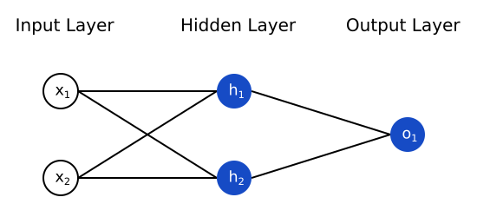
Neural Network Representation
Input Layer — This is the first layer in the neural network. It takes input signals(values) and passes them on to the next layer. It doesn’t apply any operations on the input signals(values) & has no weights and biases values associated.
Hidden Layers — Hidden layers have neurons(nodes) which apply different transformations to the input data. One hidden layer is a collection of neurons stacked vertically(Representation). In our image given above we have 1 hidden layer and it has 2 neurons.
Output Layer — This layer is the last layer in the network & receives input from the last hidden layer. With this layer we can get desired number of values and in a desired range. In this network we have 1 neuron in the output layer and it outputs o1.

Slide 3
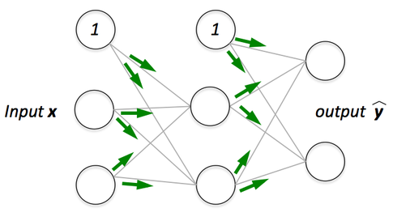
Forward Propagation
Forward propagation is a process of feeding input values to the neural network and getting an output which we call predicted value. When we feed the input values to the neural network’s first layer, it goes without any operations. Second layer takes values from first layer and applies multiplication, addition and activation operations and passes this value to the next layer. Same process repeats for subsequent layers and finally we get an output value from the last layer.

Slide 4
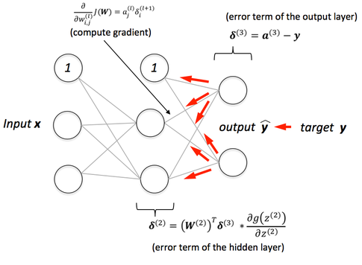
Back-Propagation
After forward propagation we get an output value which is the predicted value. To calculate error we compare the predicted value with the actual output value. We use a loss function to calculate the error value. Then we calculate the derivative of the error value with respect to each and every weight in the neural network. Back-Propagation uses chain rule of Differential Calculus. In chain rule first we calculate the derivatives of error value with respect to the weight values of the last layer. We call these derivatives, gradients and use these gradient values to calculate the gradients of the second last layer. We repeat this process until we get gradients for each and every weight in our neural network. Then we subtract this gradient value from the weight value to reduce the error value. In this way we move closer (descent) to the Local Minima(means minimum loss).

Slide 5
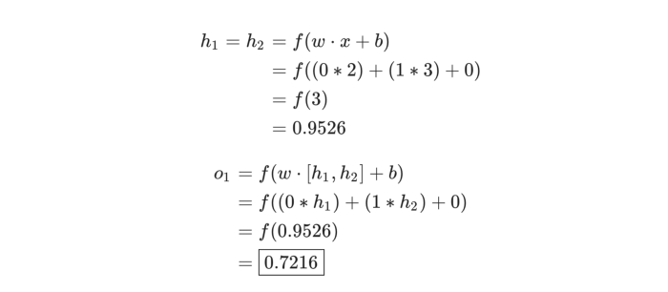
An Example: Feedforward
Let’s use the network pictured above and assume all neurons have the same weights w=[0,1], the same bias b=0, and the same sigmoid activation function. Let h1​, h2​, o1​ denote the outputs of the neurons they represent.
What happens if we pass in the input x=[2, 3]?

Slide 6
Coding a Neural Network: Feedforward
# ... code from previous section here
class OurNeuralNetwork:
''‘
A neural network with:
- 2 inputs
- a hidden layer with 2 neurons (h1, h2)
- an output layer with 1 neuron (o1)
Each neuron has the same weights and bias:
- w = [0, 1]
b = 0
''‘
import numpy as np
def __init__(self):
weights = np.array([0, 1])
bias = 0
# The Neuron class here is from the previous section
self.h1 = Neuron(weights, bias)
self.h2 = Neuron(weights, bias)
self.o1 = Neuron(weights, bias)
def feedforward(self, x):
out_h1 = self.h1.feedforward(x)
out_h2 = self.h2.feedforward(x)
# The inputs for o1 are the outputs from h1 and h2
out_o1 = self.o1.feedforward(np.array([out_h1, out_h2]))
return out_o1
network = OurNeuralNetwork()
x = np.array([2, 3])
print(network.feedforward(x))
0.7216325609518421

Slide 7
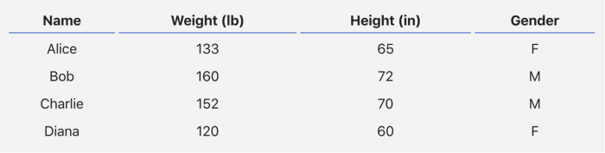

Training a Neural Network
We have the following measurements:
Let’s train our network to predict someone’s gender given their weight and height:

Slide 8
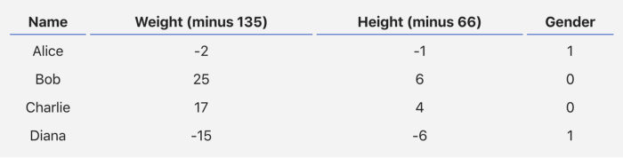
We’ll represent Male with a 0 and Female with a 1, and we’ll also shift the data to make it easier to use:

Slide 9

Loss
Before we train our network, we first need a way to quantify how “good” it’s doing so that it can try to do “better”. That’s what the loss is.
We’ll use the mean squared error (MSE) loss:

Slide 10
Let’s break this down:
n is the number of samples, which is 4 (Alice, Bob, Charlie, Diana).
y represents the variable being predicted, which is Gender.
y_true​ is the true value of the variable (the “correct answer”). For example, y_true​ for Alice would be 1 (Female).
y_pred​ is the predicted value of the variable. It’s whatever our network outputs.
(y_true​−y_pred​)² is known as the squared error. Our loss function is simply taking the average over all squared errors (hence the name mean squared error). The better our predictions are, the lower our loss will be!
Better predictions = Lower loss.
Training a network = trying to minimize its loss.

Slide 11
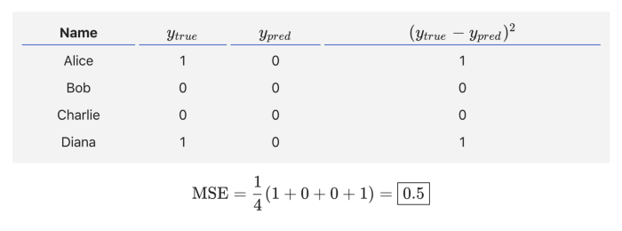
An Example Loss Calculation
Let’s say our network always outputs 0— in other words, it’s confident all humans are Male. What would our loss be?

Slide 12
Code: MSE Loss
Here’s some code to calculate loss for us:
import numpy as np
def mse_loss(y_true, y_pred):
# y_true and y_pred are numpy arrays of the same length.
return ((y_true - y_pred) ** 2).mean()
y_true = np.array([1, 0, 0, 1])
y_pred = np.array([0, 0, 0, 0])
print(mse_loss(y_true, y_pred)) # 0.5

